Slide 1
Board-Committee-Department Meeting
January 25,2024

Slide 2
Board, Committee, Department
(BCD)
Meeting Agenda
Welcome and Introductions
Governance Project Re-Cap
June BCD Meeting Actions Update
BCD Project Plan Process Breakout
Summary and Next Steps

Slide 3
Governance Project
Re-Cap
Align Master Plan Implementation with Committee, Board and Department work
Foster cohesion and cooperation on Boards and Committees
  Master Plan Recommendation Update
  Select Board Goals tied to Master Plan
  Board, Committee, Department Inventory and Survey
  First Board, Committee, Department Head Meeting (6/27/23)
  Workshopped BCD Interactions and Liaison Program
  June Meeting Action Items and Update (11/30/23)
  January BCD Meeting Update- Project Plan Process (1/25/24)

Slide 4
June Board, Committee, Department Meeting
Follow Up Action
Update
Administration
  Created BCD Contact lists- managed by Debbie Powers-Completed
  Review Meeting Minutes- Town Clerk-On-going
Training
  Handbook Updated ,training delivered September-Completed
  Researched BCD on-going training curriculum-Completed*
Technology
  Website re-design-benchmark other Town websites-On-going
  Assessed State Law for archiving-Completed
  Researched AI options for minutes-Completed
  Assessed cyber- attack risk, system modified -On-going

Slide 5
June Board, Committee, Department Meeting
Follow Up Action
Update
Board/Committee Structure
  Researched creating/disbanding Boards/Committee-Completed
  Defined parameters for creating a Task Force –Completed*
  Identified logical BCD groupings-Completed*
Further Actions
  Plan Annual Volunteer Appreciation Event (Fall)-On-going
  Running effective meeting tips- Completed*
  Assess how to communicate project updates-On-going
  Create an annual Town Calendar Timeline-yearly cycle-In Process*
*Further Information in Appendix

Slide 6
  Board, Committee, Department
  Breakout
  Standard work process guidelines
  Enhance coordination, communication and public engagement
I. (20 minutes)
  Each table brainstorms tasks under each phase
  Identify top 3-4 tasks in each group heading
  Create single table sheet
II. (10 minutes)
  Post results, review, group discussion
III. (20 minutes)
  Steve Carhart shares DIP V.2
  Group Discussion
  Nate Desrosiers shares Sweeney Park
IV. (10 minutes)
  What did you learn?

Slide 7
Board, Committee, Department Project Plan Process
Propose
Plan
Implement
Close
What is the project?
Who owns it?
Who is involved?
Who makes decisions?
How are decisions made?
What are the tasks?
How will the project be communicated?
How will the project be reviewed?
Who has final signoff?
How will the project be monitored?
How will updates be made?
Who will do them?
How will the project be closed out?
What are the steps?
Monitor and Review:
What are the steps for monitoring and reviewing the project?

Slide 8
Downtown Improvement Project 2.0
July, 2023
Manchester by the Sea Downtown Improvement Committee

Slide 9
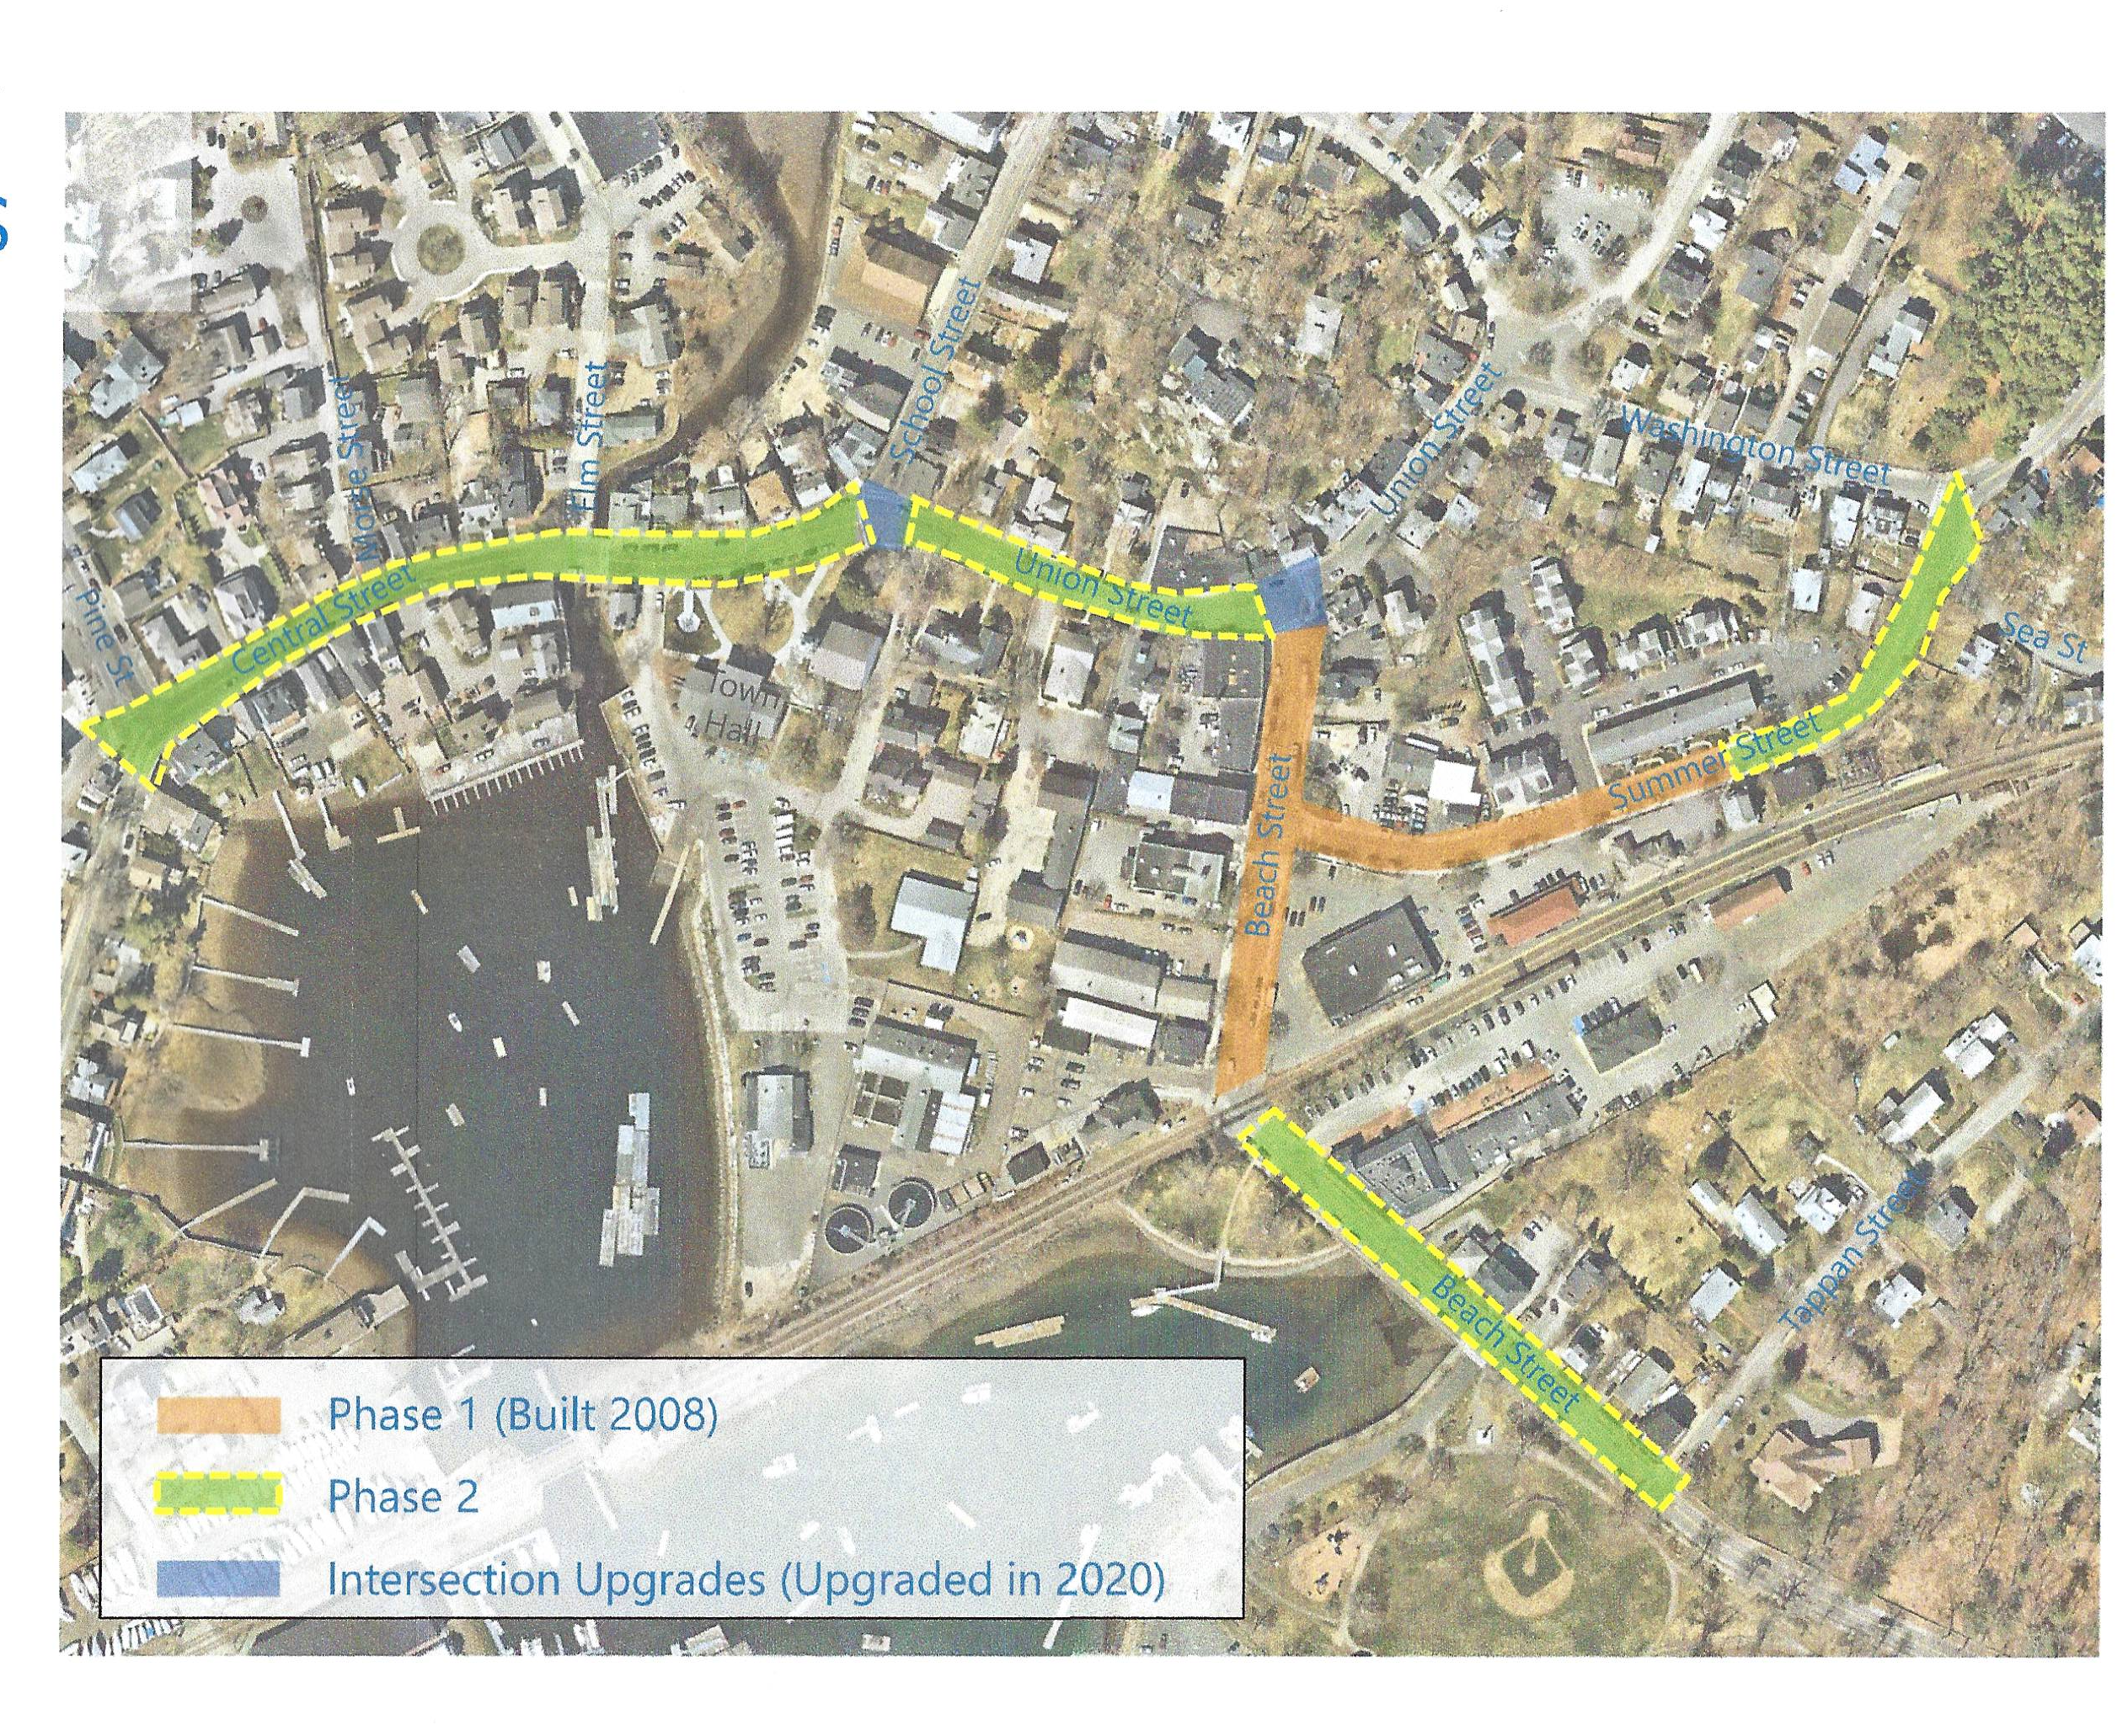
Downtown Improvement Area Mandate
Central Street: Pine to School
Union Street: School to Beach
Beach Street: Union to Tappan
Summer St.: Beach to Sea/Washington

Slide 10
Our Objective:
A unified aesthetic and safer, functional flow for downtown Manchester
Establish consistent high-quality sidewalks, curbing, and lighting throughout downtown
Enhance durability and reduce cost of patchwork repairs
Enhance usability and safety for all
Create more inviting and productive (higher tax revenue) business environment
Improve historic character and aesthetics wherever possible through attention to amenities such as green spaces, signage, and historic markers.
Integrate downtown with other municipal public works

Slide 11
Board, Committee, Department Project Plan
Propose
Plan
Implement
Close
Pre-Plan (Identify)
Project Lead and Team
Decision Makers
Influencers
Rules/Regulations
Define project:
Objectives
Scope/budget
Stakeholders
Resources/Roles
Accountability
Obtain stakeholders input
and approval
Create Project Plan:
Tasks/Stages
Timeline
Budget/ Resources
Deliverables
Define Liaison/ Roles
Create communication plan with community engagement strategy
Identify task and budget review process
Obtain stakeholder sign-off - Town Meeting
Confirm Monitor/Review Process
Confirm Decision Makers for each phase
Confirm BCD Liaisons and team update process
Set check in and milestone review dates
Establish criteria to pause, stop or move ahead
Conduct formal project review:
Evaluate project completion to objectives
Review deliverables, educate and gain stakeholder acceptance
Document success, lessons learned and Improvement areas
Define next steps
Obtain sign off and close the project
Monitor and Review:
Continuously identify, assess and mitigate risk
Ensure tasks are on time/budget and meet quality standards
Document Milestone Review decisions, feedback, recommendations
Communicate to all Liaisons on timely basis
Notes:
a

Slide 12
Sweeney Park
Project Plan
Pre-Plan
Lead
  Nate Desrosiers, MBTS Town Engineer
Team
  Cheryl Marshall, MBTS P&R Director
  Marc Resnick, MBTS Town Planner
  Weston & Samson, Consulting Design Engineers
Decision Makers
  Town Meeting
  Select Board
  Finance Committee
  Planning Board
  Conservation Commission
  Board of Health (if onsite septic is required/possible for bathrooms)
  DPW
Influencers
  Parks & Recreation Committee
  CPC
  ADA Committee
  Youth Leagues
  Community
  MERSD/Athletic Director
Rules/Regulations
  ADA Compliance, Wetlands Protection, Title 5

Slide 13
Sweeney Park
Project Plan
Project
Definition
  Objective
    Increase “playable” hours per the P&R 2020 Athletic Field Master Plan
    Construct an all season athletic field, not subject to flooding and usable for all levels
    To improve parking lot drainage and provide bathrooms
  Scope
    Solicit consulting engineering services to plan, design, bid, and construct the replacement of the Sweeney Park athletic field.
    Replacement of the existing grass soccer field with a “full size” turf or natural grass field.
    Addition of bathrooms with sewer tie-in or onsite septic.
    Improve existing parking lot drainage , replace existing dugouts, and amenities identified during project development/design (based on feedback from project decision makers, influencers, and stakeholders.
    Currently he project does not include the existing Little League baseball/softball field and dugouts, basketball courts, storage garage, concession stands, or field lighting.

Slide 14
Sweeney Park
Project Plan
Project Definition
  Constraints
    Funding
    Water table ,Wetlands buffer encroachment
    Turf vs natural grass
    Sewer Tie-in for bathroom
  Stakeholders
    P&R Committee, Select Board, Community-Coaches, Teams , Schools
  Resources
    Conservation Agent
    CPC for funding
    Town Building & Plumbing Inspectors
    Town Communications Manager
    Town Grant Coordinator
    Town Health Agent
    DPW Water & Sewer Dept
  Roles
    Nate Desrosiers, Town Project Manager
    Brandon Kunkel, W&S, Design Consultant Project Manager
    Cheryl Marshall, P&R Committee Liaison
  Accountability
    Project lead, Nate Desrosiers
    Project Review Panel

Slide 15
Summary and Next Steps
Summarize topics from the both BCD meetings
Small group discussion of impact on work to date
  What worked?
  What is missing?
  What are next steps?
Share feedback and next steps with full group
What went well in this meeting? What didn’t?

Slide 16
Appendix

Slide 17
Board, Committee, Department Project Plan Process
Propose
Plan
Implement
Close
Monitor and Review:
What are the steps for monitoring and reviewing the project?

Slide 18
BCD Training Update
MIIA (Massachusetts Interlocal Insurance Association) provides access to free training provided by All One Health.
After careful review, there are four recommended one-hour webinar training sessions for Board, Committee and Department members.
Click on the link and type in your name and email address to begin watching.
  Diversity Awareness, Recognizing Your Blind Spots 2/23/23
  Municipal Conflict Management 11/2/2022
  Expert Communication, Skills for Working Effectively with Others 6/9/2022
  Creating the Respectful Workplace 4/19/2022
All public officials (elected, appointed, and hired) are required to comply with Conflict of Interest/Code of Ethics and Open Meeting Law training.

Slide 19
Task Force Guidelines
A group of diverse stakeholders that work on a complex issue in a defined time period .
An advisory group that makes recommendations to the decision makers.
All participants are informed of the roles/responsibilities and expectations before agreeing to serve on the task force.
A timeline is set for the establishment and disbandment of the task force as well as how many meetings are expected over time.
All meetings are posted, have agendas and minutes on the Town website.
The task force leader or co-leaders are responsible for reporting results back to Task Force Leadership.
The task force makes a recommendation (advisory), but a project team is established to implement.

Slide 20
Board,
Committee
Department Groups
Administration/Finance
Assessment/Regulation
Accountant
Human Resources
Town Administrator
Town Clerk
Tax Collector
Finance Committee
Board of Registrars
Zoning Board of Appeals
Planning Board
Board of Assessors
Building Dept
Assessor
MBTA Zoning Task Force
Community Development/ Planning
Community Preservation Committee
Parks & Recreation Committee
Volunteer Application

Slide 21
Board,
Committee
Department Groups
Community Services
Manchester Coastal Stream Team
Sustainability Committee
Water Resources Protection Task Force
Open Space and Recreation Committee
Chebacco Woods Committee
Conservation Commission
Conservation Department
Winthrop Field Committee
Environment / Conservation
Veterans' Services
Schools
Parks & Recreation Dept
Library
Council on Aging
Welcoming Committee
Culture /History
Historic District/Historical Commission
Cultural Council
Seaside One Committee
July 4th Committee

Slide 22
Board,
Committee
Department Groups
Animal Control Board
ADA Advisory Committee
Board of Health
Police
Fire Department
Bicycle/Pedestrian Committee
Public Health/Safety
Infrastructure/Utilities
Harbor Management Task Force
Harbor Advisory Committee
Dept of Public Works
Harbormaster
Manchester Housing Authority
Affordable Housing Trust
Downtown Improvement Committee

Slide 23
Annual Town Event Timeline
Example
Annual Town Recurring Events
January
  Census Mailing and responses
  Campaign Finance report for all elected officials
  Annual Town Report
  Annual Town Election & Town Meeting Schedule
  Nomination papers ready
  Business Licenses entered into The DOR website
February
  Registrars Appointment
  Annual State Ethics Training/Acknowledgment
March
  Dog Registrations
  Presidential Primary (every 4 years)
April
  Annual Town Meeting
  Street List
  Flammables Annual Registration
May
  Annual Town Election
  Swearing in Elected Officials-On Boarding
June
  Inactivation of census non-respondents
July
  Assessor Certification in DOR
August
  Follow up with all appointed officials
  Committee/Board training
September
  State Primary (every two years)
  Hunter registration
  Budget Preparation
October
  Elementary School dog tag election
  Tax Rate Certification
November
  State election (every two years)
December
  Prep for annual destruction of files

