Slide 1
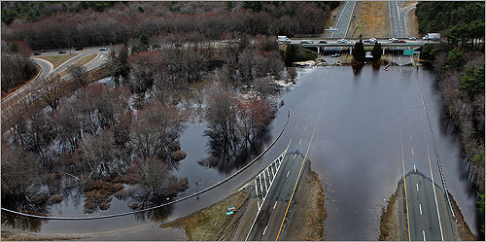
Hazard Mitigation planning process december 8, 2014 – CMRPC
Hazard Mitigation Planning Process May 12, 2015 – Manchester– PDM14

Slide 2
MITIGATION
Most effective when it is based on a comprehensive, long-term plan that is developed before a disaster occurs.
Purpose is to identify local policies and actions/projects that can be implemented over the long term to reduce risk and future losses from hazards.
Based on an assessment of hazards, vulnerabilities and risks, and the participation of a wide range of stakeholders and the public in the planning process.

Slide 3
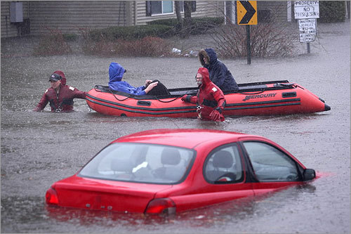
MITIGATION Cont.
Benefits:
Identify actions for risk reduction agreed upon by stakeholders and public
Focus resources on the greatest risks and vulnerabilities
Build Partnerships – businesses, organizations, and citizens
Increase education and awareness
Tool to communicate priorities to local, state, and federal
officials
Align risk reduction with other community objectives
Notes:
Mitigation is most effective when it is based on a comprehensive, long-term plan that is developed before a disaster occurs. The purpose of mitigation planning is to identify local policies and actions that can be implemented over the long term to reduce risk and future losses from hazards. These mitigation policies and actions are identified based on an assessment of hazards, vulnerabilities and risks and the participation of a wide range of stakeholders and the public in the planning process. Benefits of mitigation planning include: (above list)

Slide 4
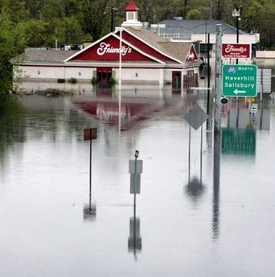
Why?
States and local jurisdictions are required to have a FEMA approved Hazard Mitigation Plan:
“… to be eligible for project grants under HMGP… and other grant programs such as the Pre-Disaster Mitigation Program.”
(DMA 2000)

Slide 5
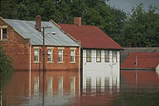
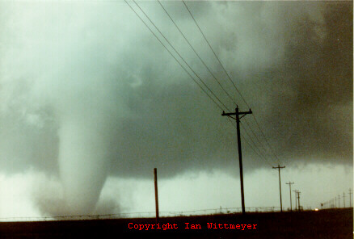
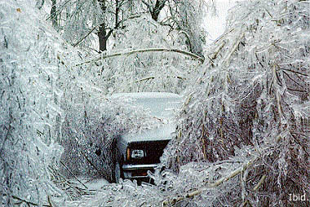
Why?
A local jurisdiction must review and revise its plan
every 5 years
to reflect changes in development,
progress in local mitigation efforts,
and changes in priorities
44CFR 201.6(d)(3)

Slide 6
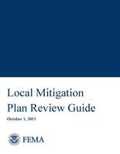
What?
FEMA’s Local Mitigation Plan Review Guide (Oct. 1, 2011)
FEMA’s Local Mitigation Planning Handbook
FEMA’s Local Multi-hazard Mitigation Planning Guidance
(July 1, 2008 edition)
Other local & regional plans
Other current related plans (CEMP, ERP’s, COMP, CIP, open space, floodplain, coastal management, etc.)

Slide 7
Who? Hazard Mitigation Committee
Planning Department – any with authority to regulate development
Floodplain Manager, CRS Coordinator
Emergency Management Department
Public works and Building Department
Utilities – water wastewater, gas,
Transportation (roads and bridges)
Fire Department
Police Department
Public officials
County and city planners, RPC staff
Critical structures proprietors (i.e. schools, hospitals, law enforcement facilities)
Flood managers, CRS coordinators
Geographical Information Systems (GIS)
Environmental / Parks and Recreation
other stakeholders - Agencies, businesses & organizations (nonprofits, neighborhood Assn’s, museums, libraries) and John Q. public

Slide 8
Planning Team Initial Steps
Confirm Plan Purpose – Mission Statement
Refine plan scope and schedule – if received a grant work backwards from the POP
Establish Roles & Responsibilities
Develop an outreach strategy
Document, document, document
Notes:
3) You all have competing responsibilities so discuss up front expectations of roles/time commitment. Identify gaps or shortfalls if resources needed.
Provide facilities for meetings
Attend meetings
Collect data
Management administrative details – in-kind match
Make decisions on planning process and content
Strategy development/prioritization
Review drafts

Slide 9
Things to remember for an update
“Plan updates must demonstrate that progress has been made in the past 5 years for Local Mitigation Plans to fulfill commitments outlined in the previously approved plan…
What did you say
you were going to do?
Did you do it?
If not, it is okay, just provide an explanation and adjust

Slide 10
Questions?

Slide 11
Planning Process
A1. Does the Plan document the planning process, including how it was prepared and who was involved in the process for each jurisdiction 44 CFR 201.6(c)(1) (a-e)
Must
Include schedule/timeframe and activities (factual evidence)
Participating jurisdiction(s)
Who – Person’s position/title and agency/organization
Document how they were involved in the process
How were they engaged as participants and given the chance to provide input to affect the plan’s content.

Slide 12
Planning Process
A2. Does the Plan document an opportunity for neighboring communities, local and regional agencies involved in hazard mitigation activities, agencies that have the authority to regulate development… involved in the planning process? 44 CFR 201.6(b)(2)
At minimum:
Local and regional agencies involved in HM activities;
Agencies that have the authority to regulate development; and
Neighboring communities
You must show who and how - - this includes letters, emails, ads, website postings etc.

Slide 13
Planning Process
A3. Does the Plan document how the public was involved in the planning process during the drafting stage? 44 CFR 201.6(b)(1) and 201.6(c)(1)
Must:
During the drafting stage and
Just prior to the Planning Team approving the draft to be sent to MEMA/FEMA for review.
Provide detail on how the public was given the opportunity and HOW their feedback (if any) was incorporated into the plan

Slide 14
Planning Process
A4. Does the Plan document the review and incorporation of existing plans, studies, reports, and technical information? 44 CFR 201.6(b)(3)
What and How incorporated – be as specific as possible.
Incorporate means to reference or include information from other existing sources to form the content of the mitigation plan.

Slide 15
Planning Process
A5. Is there discussion on how the community(ies) will continue public participation in the plan maintenance process? 44 CFR 201.6(c)(4)(iii)
Participation means engaged and given the chance to provide feedback. Be specific as possible about the mechanism they will be given to provide feedback.

Slide 16
Plan Maintenance
A6. Is there a description of the method and schedule for keeping the plan current (monitoring, evaluating and updating the mitigation plan within a 5‐year cycle)? 44 CFR 201.6(c)(4)(i)
Monitoring – tracking implementation
Evaluating – assessing the effectiveness
Updating – reviewing and revising (how, when, and who)
Must include title of individual or dept./agency responsible to lead each of the efforts above

Slide 17
Questions?

Slide 18
and Vulnerability

Slide 19
Risk Assessment
Risk Assessment is the process of measuring the potential loss of life, personal injury, economic injury, and property damage resulting from hazards and the likelihood of future occurrences.
Step 1: Identify and Profile hazards.
Step 2: Inventory community assets.
Step 3: Analyze Risk - Estimate losses.
Step 4: Summarize Vulnerability.

Slide 20
Step 1: Identify and Profile Hazards
B1. Does the Plan include a description of the type, location, and extent of all natural hazards that can affect each jurisdiction? 44 CFR 201.6(c)(2)(i) and 44 CFR 201.6(c)(2)(iii)
Type - brief description of what it looks/feels like.
***Provide rationale for omitting any SHMP hazards***
Location or Geographical Area – if the same for entire planning area just say that.
Extent (magnitude or strength) - how bad can it get?
Hurricane = Saffir-Simpson Scale
Earthquake = Richter Scale
Wildfire = acres burned

Slide 21
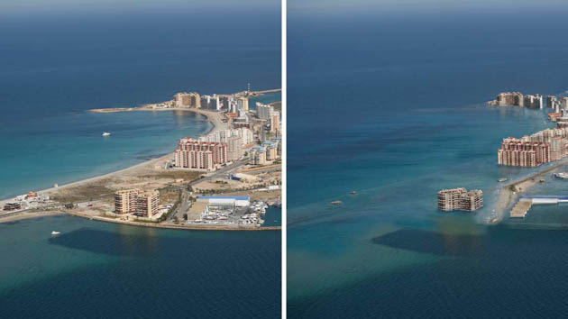
Hazards in the State HM Plan
Coastal Erosion
Dam Failure
Earthquake
Wildfires
Flooding
Hurricanes/Tropical Storms
Landslide
Nor’easter
Severe Weather
Severe Winter Storm
Tsunami
Climate Change = Existing Hazards Exacerbated

Slide 22
Step 1: Identify and Profiles Hazards
B2. Does the Plan include information on previous occurrences of hazard events and on the probability of future hazard events for each jurisdiction? 44 CFR 201.6(c)(2)(i)
Historic occurrences
Probability of future occurrence
Probability means the likelihood of occurring and may be defined in general terms (ex. Unlikely, likely, highly likely etc.) Must define terms assigning a %.

Slide 23
Step 2: Inventory assets.
What is the vulnerability?
What can be affected? “Populations, the types and numbers of existing and future buildings, infrastructure, and critical facilities located in the identified hazard areas” §201.6 (c)(2)(ii)(A)
It is the “so what” element.
Notes:
To take the RA to the next level, the who cares level…
So we have this hazard, we know what it can potentially do, where (maybe), how often, etc, but what we really need to know is what is that natural hazard going to do?
Asset inventory or Critical Facilities Inventory will be used to assess what assets will be affected by the hazard event?
Lists vulnerable structures will be analyzed with
type of hazard
description of structure
dollar values or percentage of damages possible

Slide 24
Step 2: Inventory assets
People – most important asset
Areas of greatest density
Populations with unique vulnerabilities
Non-English speaking
Visiting
Access and Functional Needs
Economy
Natural Environment

Slide 25
Step 2: Inventory assets
Built Environment
Existing Structures
Infrastructure
Critical Facilities
Essential facilities - hospitals, police and fire stations, emergency operations centers, evacuation shelters, and schools
Transportation systems- airports, highways, railways, and waterways.
Lifeline utility systems - potable water, wastewater, oil, natural gas, electric power, and communication systems.
High potential loss facilities - power plants, dams, and military installations.
Hazardous material facilities - hazardous materials sites
Cultural Resources
Notes:
Incorporate in the asset inventory an overview, or summary, of the impact on the community's vulnerable structures. Include, by type of hazard, a general description of the types of structures (e.g., buildings, infrastructure, and critical facilities) affected by the hazard. For example, flooding will affect all structures whose lowest floors are built below the base flood elevation. Include a general description of the extent of the hazard's impact to vulnerable structures. This description can be presented in terms of dollar values or percentage of damages. Among the most urgent and important assets within the community are critical facilities. The community will be able to make better decisions about how to expend resources to protect critical facilities as a result of this type of assessment.
Preface with… This is the FEMA mitigation plan guidance list of CF’s. This list is not exhaustive and is certainly not what the community is tided to.
Critical facilities include the following:
Essential facilities for the health and welfare of the whole population
hospitals, police and fire stations, emergency operations centers, evacuation, shelters, and schools
Transportation systems
airways, highways, railways, and waterways
Lifeline utility systems
potable water, wastewater, oil, natural gas, electric power, and communication systems
High potential loss facilities
nuclear power plants, dams, and military installations
Hazardous material facilities
corrosives, explosives, flammable materials, radioactive materials, and toxins
Special Consideration Areas and Areas of Historical / Cultural / Natural Significance
Special consideration areas – resulting in high death toll or injuries, economic losses – ex – high densities, industrial development areas, etc.
Anything else that needs particular attention?

Slide 26
Step 3: Analyze Risk
B3. Is there a description of each identified hazard’s impact on the community as well as an overall summary of the community’s vulnerability for each jurisdiction? 44 CFR 201.6(c)(2)(ii)
Impact - consequences or effect on community and its assets. Actual historic or potential.
Overall summary - more than a list but rather key issues or problem statements that clearly describes the greatest vulnerabilities that will be connected in the mitigation strategy

Slide 27
Step 3: Analyze Risk – Estimate Losses
How will the community’s assets be affected by the hazard event?
Estimate the losses to structures.
Estimate the losses to contents.
Estimate the losses to structure use and function.
Calculate the loss from each hazard event.
Calculate the losses to each asset.
Calculate the estimated damages for each hazard event
Notes:
Step 3 Estimate Losses. This answers the question: “How will the community’s assets be affected by the hazard event?”
This step provides the community and the State with a common framework in which to measure the effects of hazards on vulnerable structures. Steps 1 to 3 of the risk assessment phase involve gathering data on the hazards that may affect the community and the assets that can be damaged by the hazard event. All that information will be put to use in the fourth and final step, Estimate Losses.
This step is not required for approval of a local hazard mitigation plan by FEMA. HOWEVER, new and updated plans do need to talk about the properties insured under the NFIP. Historically, communities/RPA’s used the NFIP loss data as an indicator for the estimation of losses

Slide 28
How
Analysis Options
Exposure
Historical
Scenario
Powerful tool for mitigation and recovery planning and analysis
HAZUS-MH is a geographic information system (GIS) software package that uses census data and other existing databases to estimate damage and losses.
Notes:
Many RPA’s, Towns, and cities do their own analysis by using maps and GIS information from their own existing databases, which is completely acceptable.
FEMA has developed a loss estimation model that is useful in estimating losses from earthquakes, floods and hurricane winds. HAZUS-MH is a geographic information system (GIS) software package that uses census data and other existing databases to estimate damage and losses, including:
Physical damage: damage to residential and commercial buildings, schools, critical facilities, and infrastructure;
Economic loss: lost jobs, business interruptions, repair and reconstruction costs
Social impacts: impacts to people, including requirements for shelters and medical aid.
During the past decade, HAZUS-MH has evolved into a powerful tool for mitigation and recovery planning and analysis. An increasing number of states and localities are using HAZUS-MH in the preparation of risk assessments and mitigation plans under the Disaster Mitigation Act of 2000. HAZUS-MH is also being used to support post-disaster planning for recovery from hurricanes, earthquakes, and floods.
Plug for NESEC?

Slide 29
Step 4: Summarize Vulnerability
B3. Is there a description of each identified hazard’s impact on the community as well as an overall summary of the community’s vulnerability for each jurisdiction? 44 CFR 201.6(c)(2)(ii)
Impact - consequences or effect on community and its assets. Actual historic or potential.
Overall summary - more than a list but rather key issues or problem statements that clearly describes the greatest vulnerabilities that will be connected in the mitigation strategy

Slide 30
Step 4: Summarize Vulnerability
Summarize data gathered in previous steps (hazards, vulnerable assets, impacts and losses)
Problem Statements
The Massville Sewage Treatment Plant is located in the 100-year floodplain and has been damaged by past flood events. It serves 10,000 residential and commercial properties.

Slide 31
Step 4: Summarize Vulnerability
B4. Does the Plan address NFIP insured structures within each jurisdiction that have been repetitively damaged by floods? 44 CFR 201.6(c)(2)(ii)
Types (residential, commercial, institutional) and number of repetitive loss properties
Richard Zingarelli 617-626-1406 Richard.Zingarelli@state.ma.us

Slide 32
Questions?

Slide 33
Mitigation Strategy
The mitigation strategy serves as
the long-term blueprint
for reducing the potential losses identified in the risk assessment.
Was there progress in local mitigation efforts?
Were there any changes in priorities?

Slide 34
Mitigation Strategy
C1. Does the plan document each jurisdiction’s existing authorities, policies, programs and resources, and its ability to expand on and improve these existing policies and programs? 44 CFR 201.6(c)(3)
Planning and regulatory
Administrative and technical
Financial
Education and outreach
See worksheets 4.1, 4.2, and 4.3 in the Local Mitigation Planning Handbook

Slide 35
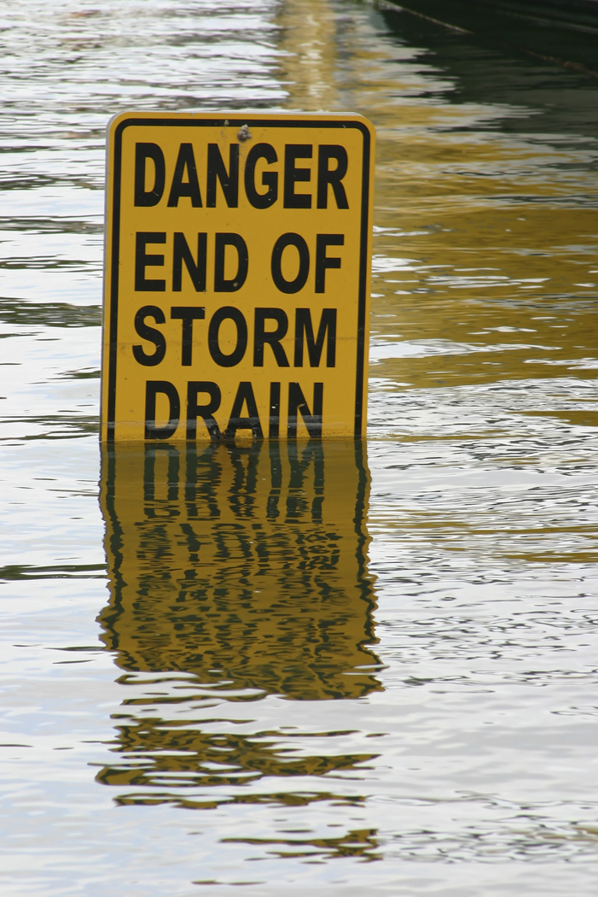
Mitigation Strategy
C2. Does the Plan address each jurisdiction’s participation in the NFIP and continued compliance with NFIP requirements, as appropriate? 44 CFR 201.6(c)(3)(ii)
How is the community going to implement and maintain their Floodplain program over the next 5 years?
Floodplain ordinance
Wetlands Protection Act
Open Space Plan…. Etc.

Slide 36
Community Rating System
Communities policies are at a reduced rate.
Additional activities that go above and beyond the minimum requirements of NFIP participation.

Slide 37
Mitigation Strategy
C3. Does the Plan include goals to reduce/avoid long‐term vulnerabilities to the identified hazards? 44 CFR 201.6(c)(3)(i)
Must be consistent with the hazards identified in the plan.
Broad policy-type statements (long-term outcomes) that explain what the community wants to achieve.
Visions for reducing or avoiding losses from identified hazards.
Tie to goals of other community planning mechanisms or reflective of current State HMP goals?

Slide 38
Mitigation Strategy
C4. Does the Plan identify and analyze a comprehensive range of specific mitigation actions and projects for each jurisdiction being considered to reduce the effects of hazards, with emphasis on new and existing buildings and infrastructure? 44 CFR 201.6(c)(3)(ii) and 44 CFR 201.6(c)(3)(iv)
Comprehensive range of various HM alternatives that address the vulnerabilities to the hazards the jurisdiction(s) determine are most important.

Slide 39
Mitigation Strategy
C5. Does the Plan contain an action plan that describes how the actions identified will be prioritized (including cost benefit review), implemented, and administered by each jurisdiction? 44 CFR 201.6(c)(3)(iii) and 44 CFR (c)(3)(iv)
Must:
Describe criteria to prioritize actions
Demonstrate analysis considered benefits vs. costs
Department responsible for implementing actions
Potential funding sources (be as specific as possible, and
Implementation timeline – days, months, years.

Slide 40
Mitigation Strategy
C6. Does the Plan describe a process by which local governments will integrate the requirements of the mitigation plan into other planning mechanisms, such as comprehensive or capital improvement plans, when appropriate? 44 CFR 201.6(c)(4)(ii)
Must:
Describe process to integrate data, info., goals, actions...
Identify the local planning mechanism where it may be incorporated.
To demonstrate progress, the updated plan include how it was incorporated over last 5 years, when appropriate

Slide 41
Questions?

Slide 42
Plan Review, Evaluation, and Implementation (Updates Only)
D1. Was the plan revised to reflect changes in development? 44 CFR 201.6(d)(3)
Changes in development that occurred in hazard prone areas that either increased or decreased the vulnerability of each jurisdiction since last plan approval (last 5 years).
Examples include:
Construction completed over last 5 years
Potential development (planned or under consideration), or
Conditions that may affect the risks and vulnerabilities

Slide 43
Plan Review, Evaluation, and Implementation
D2. Was the plan revised to reflect progress in local mitigation efforts? 44 CFR 201.6(d)(3)
Must:
Describe status of HM actions from previous plan – completed, deleted, deferred, etc.
For actions not yet completed these can be carried over to the updated list but you MUST include as must detail as possible what has been done over the last 5 years. If nothing, then provide brief description as to why.

Slide 44
Plan Review, Evaluation, and Implementation
D3. Was the plan revised to reflect changes in priorities? 44 CFR 201.6(d)(3)
Since the last plan has there been any changes in the priorities of your mitigation program in terms mitigation projects/actions due to changes in financial and/or political realities or changes in conditions or priorities due to disaster events.
Tip
Just say if there are no changes in hazard priorities/conditions.
If the action/project list in the previous plan was not prioritized then say that but also say they will be analyzed during the next update process ...

Slide 45
Plan Adoption
E1. Does the Plan include documentation that the plan has been formally adopted by the governing body of the jurisdiction requesting approval? 44 CFR 201.6(c)(5)
E2. For multi‐jurisdictional plans, has each jurisdiction requesting approval of the plan documented formal plan adoption? 44 CFR 201.6(c)(5)
***Include an unsigned copy of the adoption resolution template on community letterhead.***
Notes:
Demonstrates the community’s commitment to implementing the mitigation strategy and authorizes responsible agencies to execute their actions.
Formal adoption resolution to be signed by the governing body/person who has the authority to implement actions. Typically the Board of Selectmen, City/Town Council, Manager etc.

Slide 46
Multi-Hazard Mitigation Plan Submission and Approval Flow Chart
Draft HM Plan submitted with completed Checklist
Important Requirements:
All plan submissions must be electronic files, submitted via email or CD/DVD.
Plans and Maps must be less than 9MB per file.
Must submit complete contact information for all local officials (email and mailing address)
Only complete drafts can be submitted to FEMA for review. MEMA will review partial draft on request.
Approval Pending Adoption (Conditional Approval) are only valid for one year from the date of issue.
MEMA Reviews Plan and Checklist
FEMA -Approved Plan
FEMA Review Plan and Checklist
FEMA Issues a Final Approval
FEMA Issues Approval Pending Adoption (email)
Community Adopts the Plan
Community Forwards Adoption to FEMA thru MEMA
January 2012

Slide 47
Questions?

