Slide 2
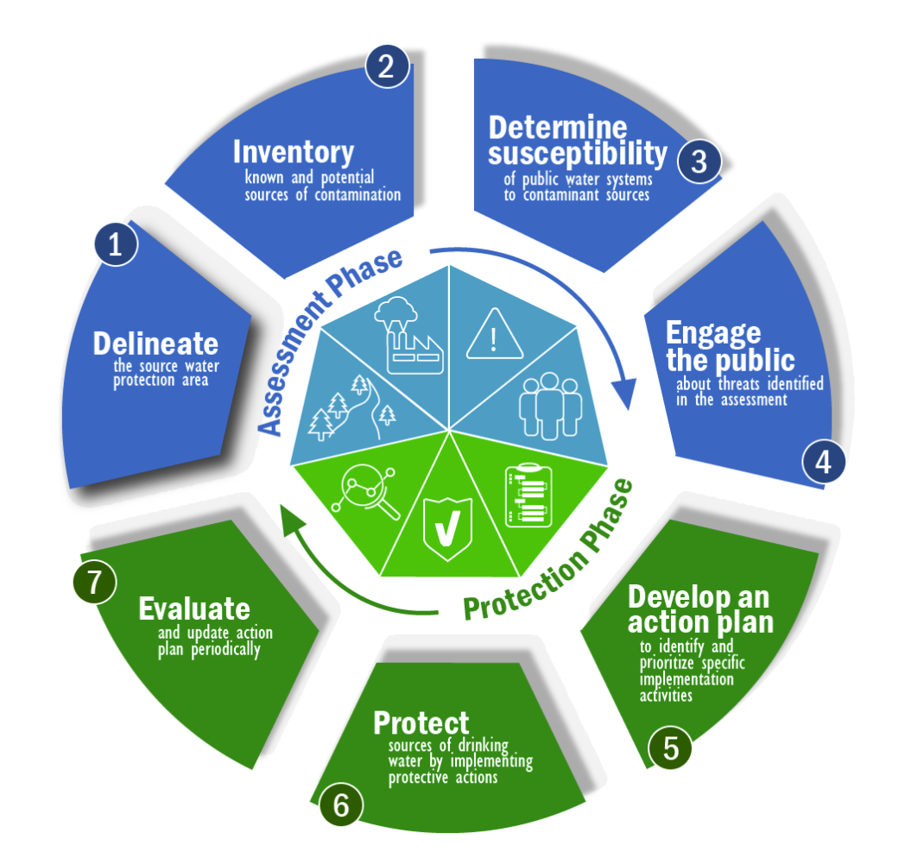

Slide 3
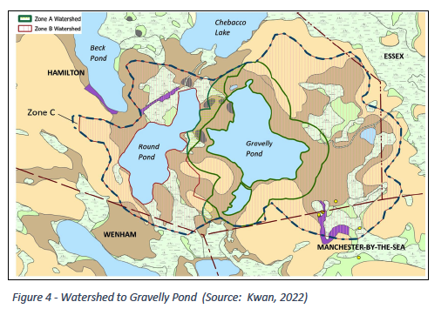

Slide 4
Zone I (circles) includes a 400-foot protective radius around Round Pond Well #1 and a 250-foot protective
radius around Round Pond Well #21. The various size radii are calculated based upon the pumping rates
of the two wells.
Zone 2 (red line) is that area of an aquifer that contributes groundwater to the well under the most severe
pumping and recharge conditions that can be realistically anticipated (180 days of pumping at approved
yield, with no recharge from precipitation).
Zone 3 (dashed line) is the adjacent upland areas comprised of less permeable materials such as glacial till and bedrock that contribute to the Zone 2 areas.

Slide 5
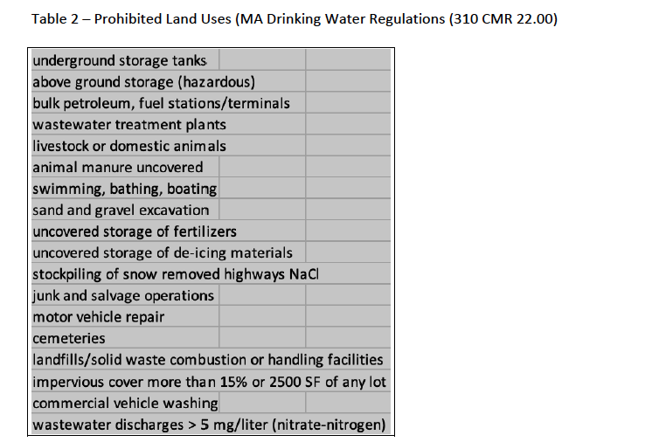

Slide 6
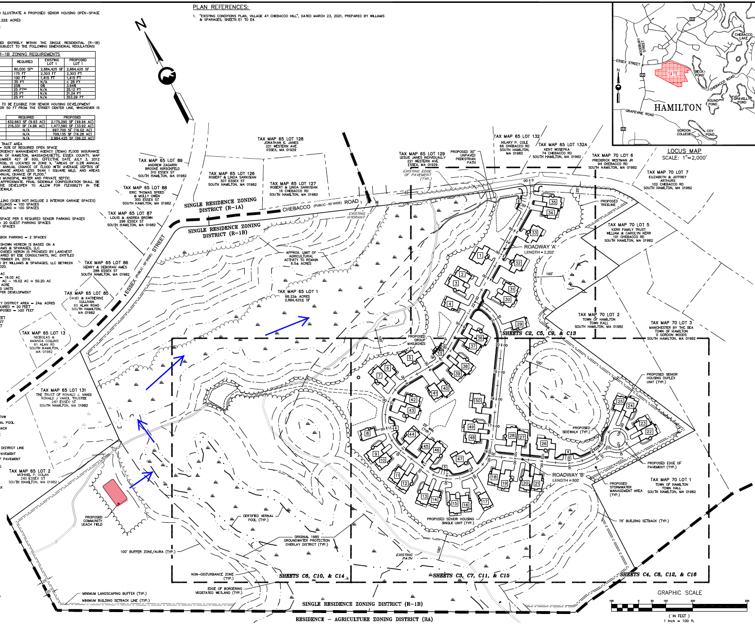

Slide 7
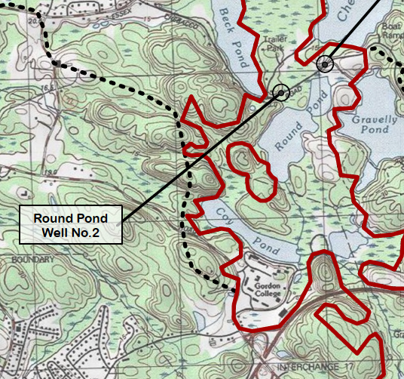

Slide 9
The Precautionary Principle
“when an activity raises threats of harm to human health or the environment, precautionary measures should be taken even if some cause and effect relationships are not fully established scientifically”.

Slide 10
Recommendations

