Slide 1
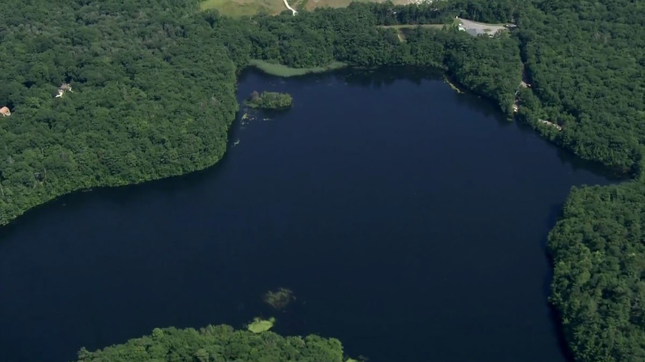
Special Project : Manchester-by-the-Sea, MA
Gravelly Pond, MA Protection Zone Mapping
Prepared by Cynthia Kwan
Fall 2022 ENVR E-166 Water Resources Policy and Watershed Management Professor Scott Horsley
Image Source: https://www.wcvb.com/

Slide 2
Drinking Water Regulation 310 CMR 22.02 Definitions
Watershed:
“the area contained within geomorphic or topographic boundaries of higher elevations which cause Surface Water
and/or Groundwater to drain or flow to lower elevations into water used as a Public Water System source.”

Slide 3
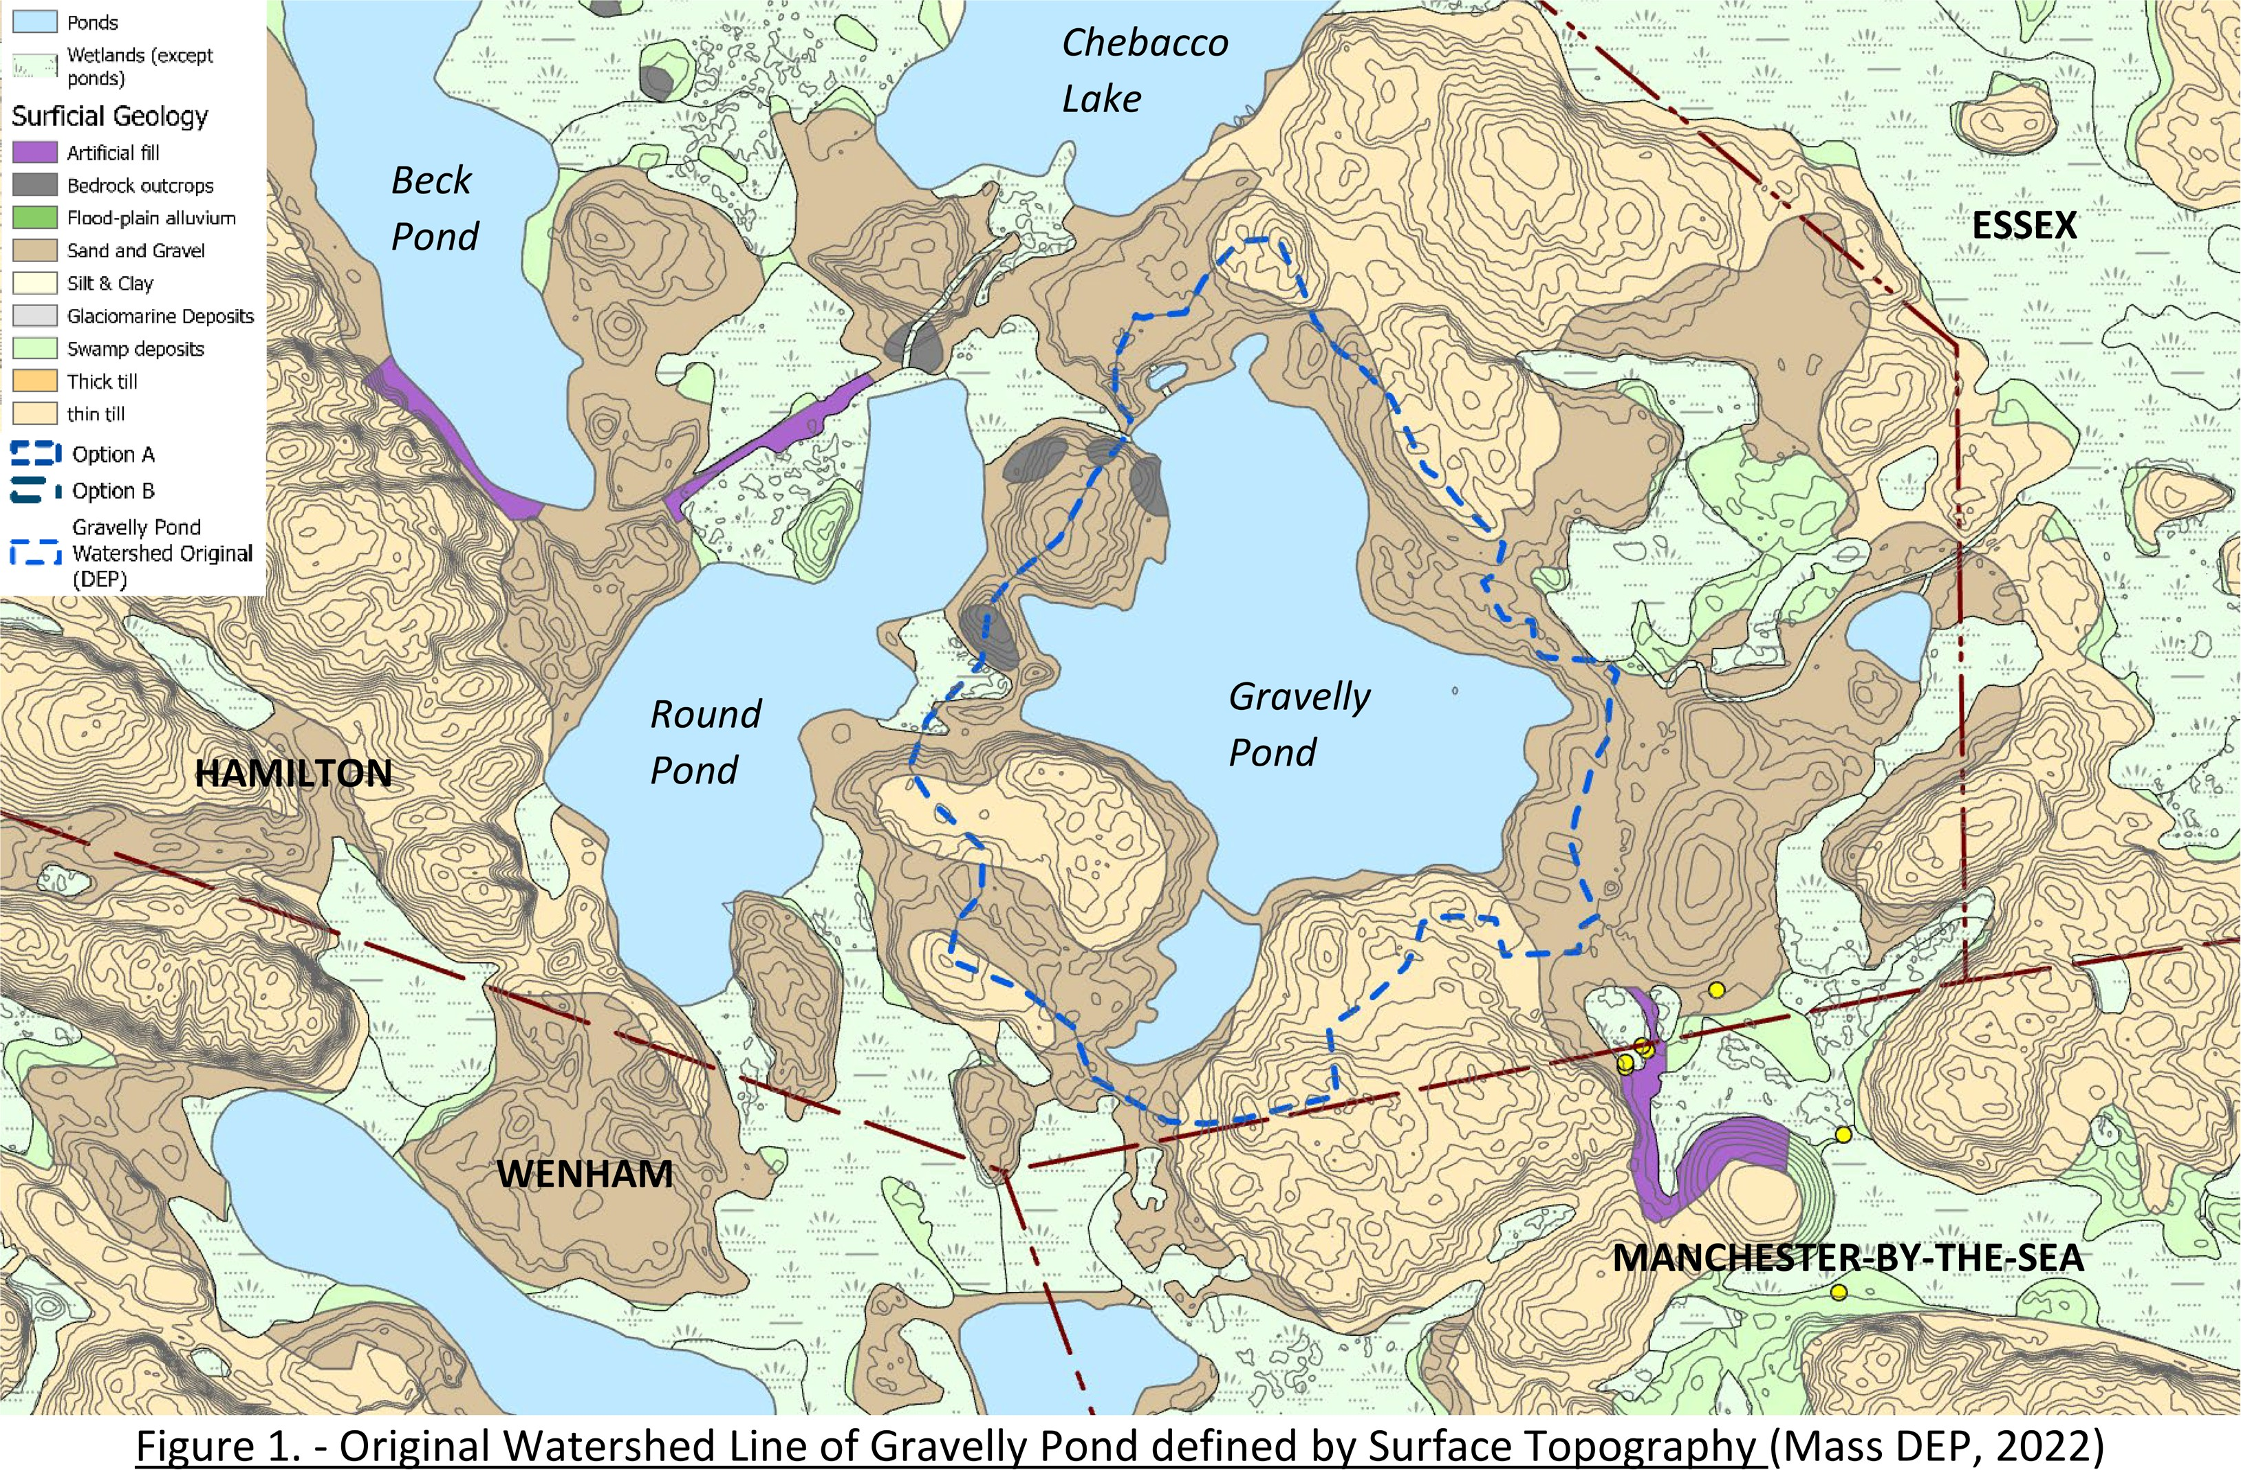

Slide 4
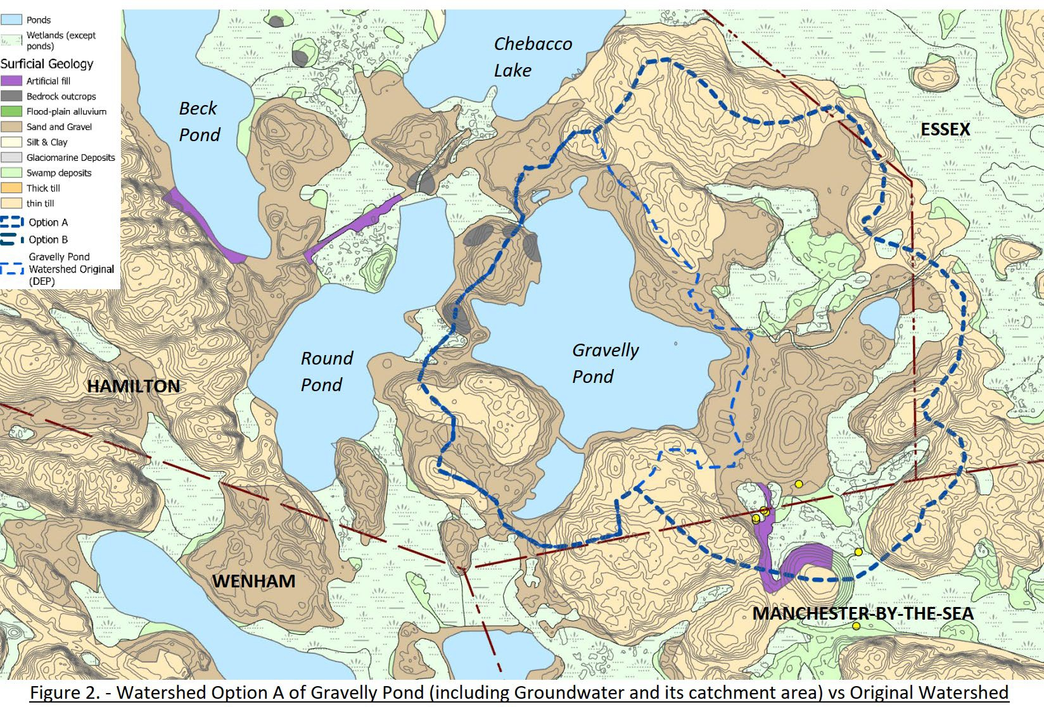

Slide 5
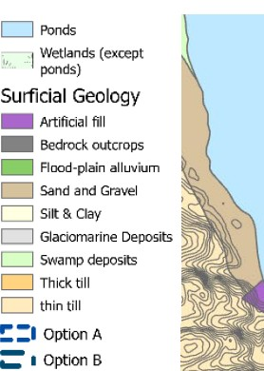
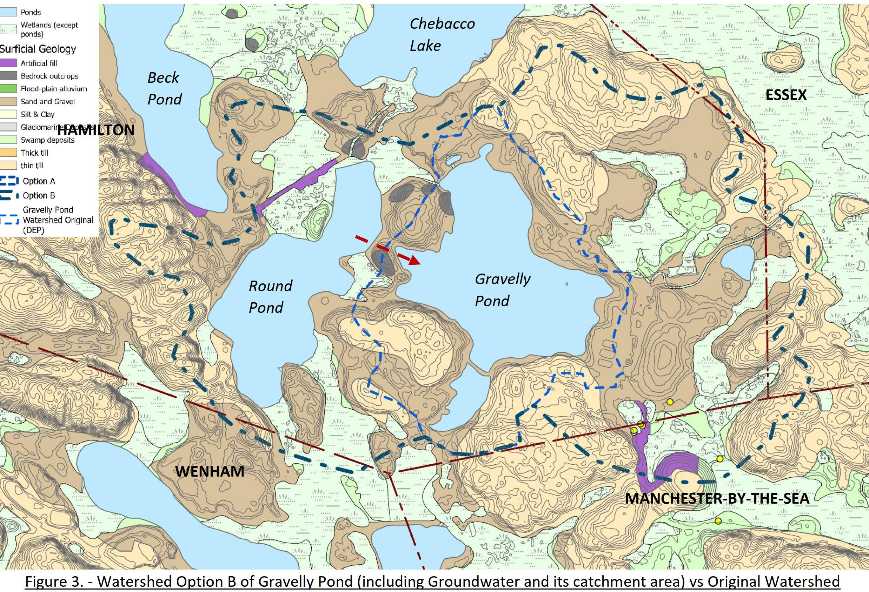
HAMILTON

Slide 6
Drinking Water Regulation 310 CMR 22.02 Definitions
Surface Water Source Protection Zone:
A
Zone A : 400 feet lateral distance from Surface Water boundary
Gravelly Pond
Zone B:
land area within ½ mile of Surface Water boundary within the watershed
Zone C:
land area within the watershed but not Zone A or B

Slide 7
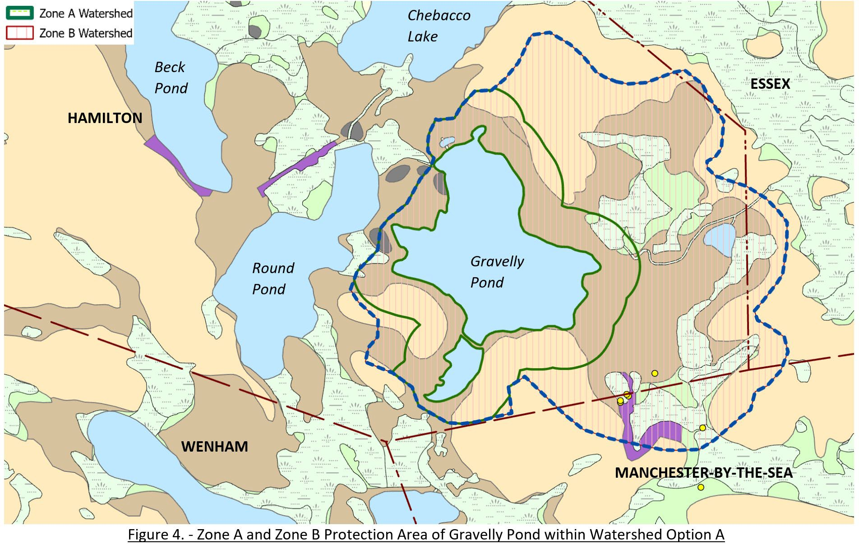

Slide 8
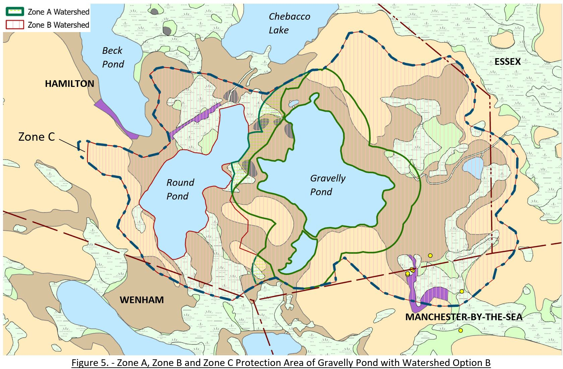

Slide 9
Drinking Water Regulation 310 CMR 22.02 Definitions
Well Protection Zones:
Zone I: 400 feet protective radius
II
I
Well
Zone II:
area of an aquifer bounded by the groundwater divides that result from pumping the well &
less permeable materials such as till or bedrock.

Slide 10
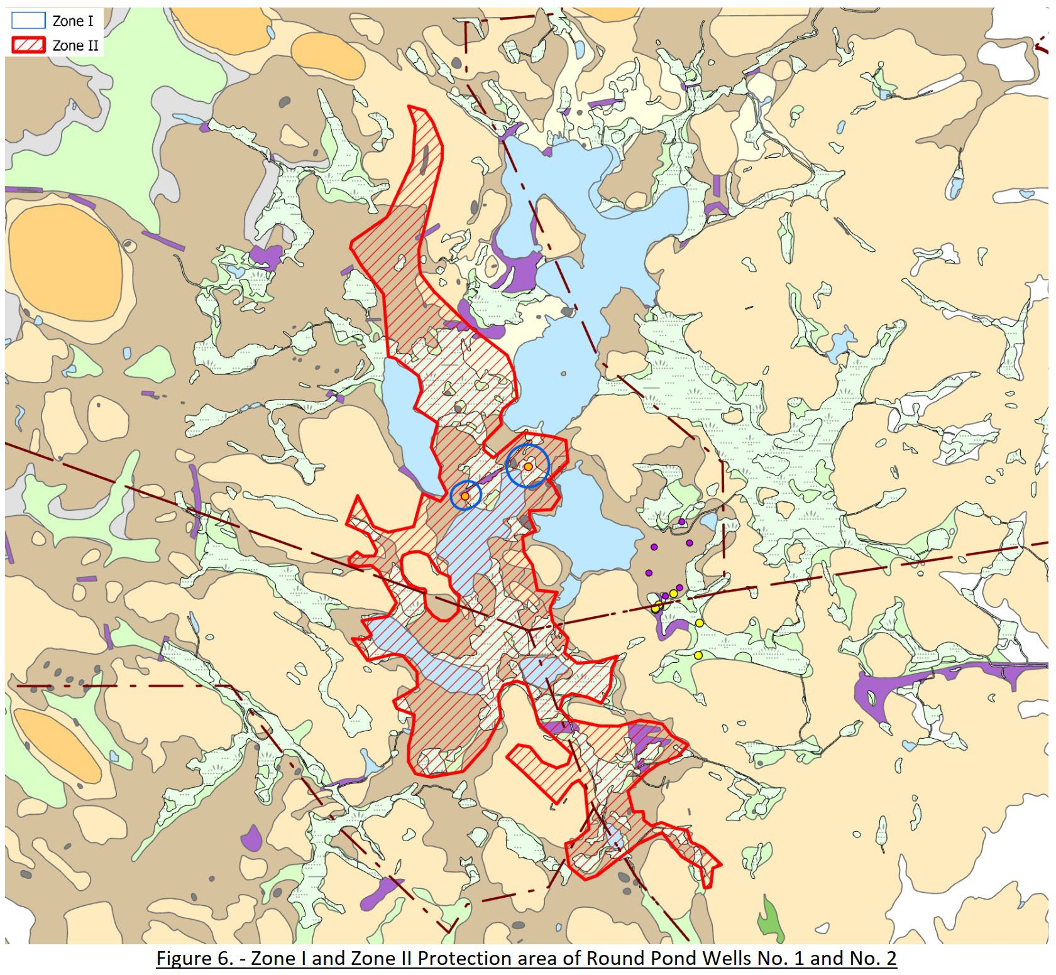

Slide 11
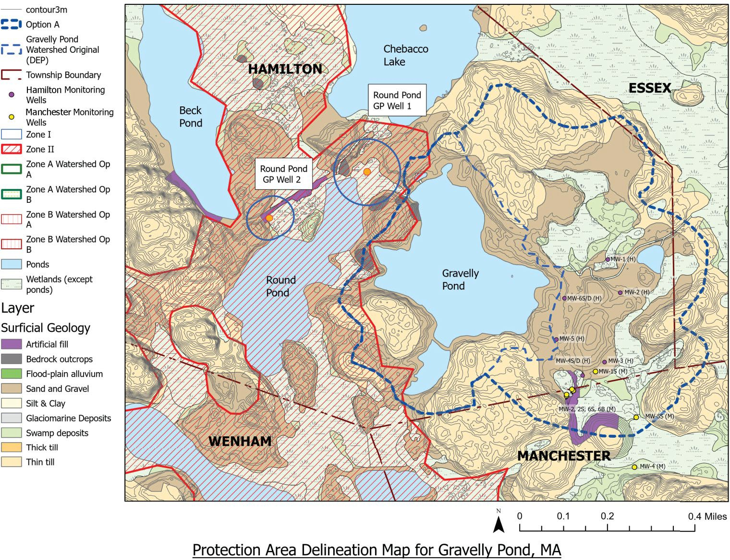

Slide 13
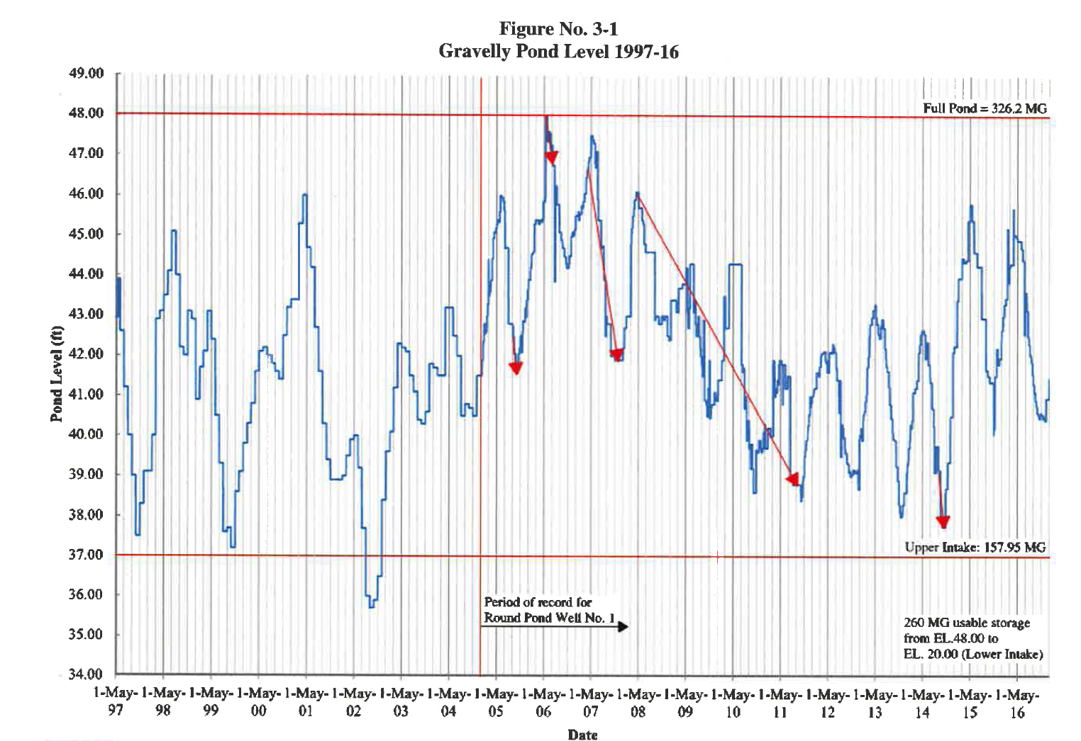
`

Slide 14
Hydrologic Budget – Gravelly Pond
million gallons/day (MGD)

Slide 15
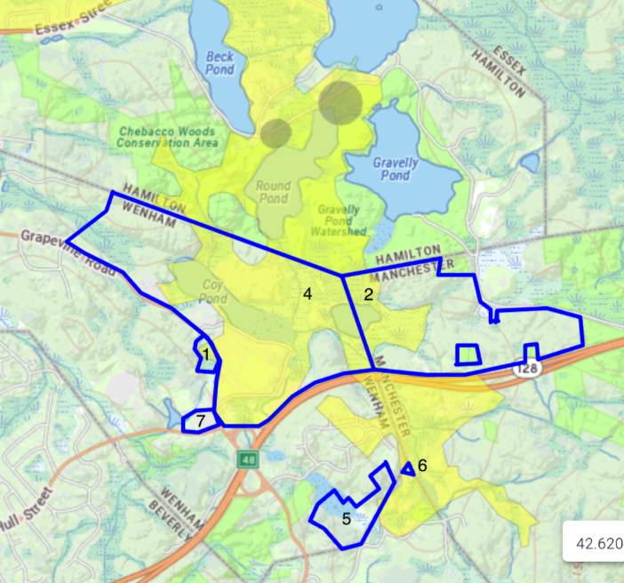

Slide 16
Thank you
Image Source: https://www.wcvb.com/

