Slide 1
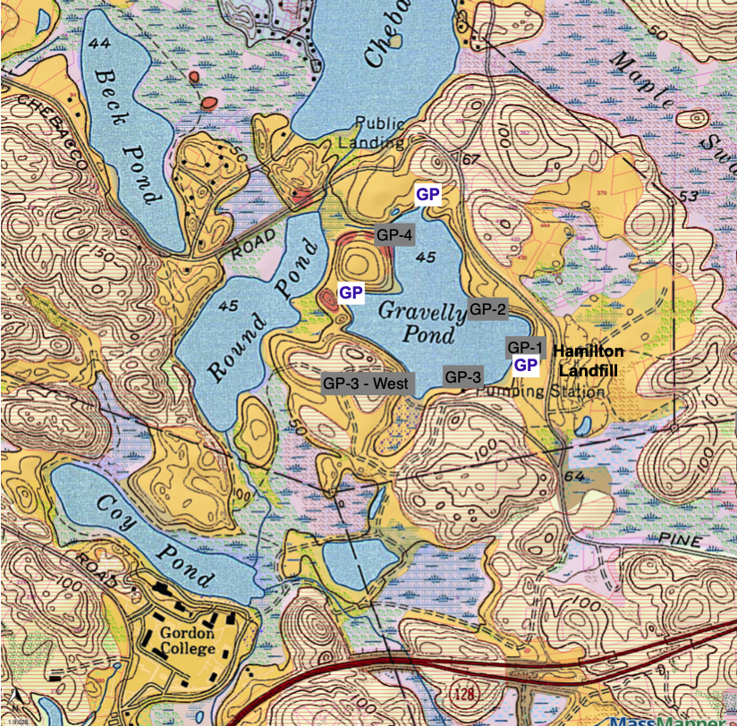
Thermal Study of Groundwater Flow

Slide 2
DRAFT Water Resource Protection Areas
Zone A – 400’ from reservoir
Zone B – watershed to reservoir (black line)
Zone 1 – 400’ to Round Pond well (yellow)
Zone 2 – groundwater flow to Round Pond well (green)
Zone 3 – watershed to Zone 2 (red line)

Slide 3
Zone 2 protection area to Round Pond wells (CDM)

Slide 5
HAMIL
Preliminary DRAFT
Water Resource Protection Area
Gravelly Pond
WENHAM

Slide 6
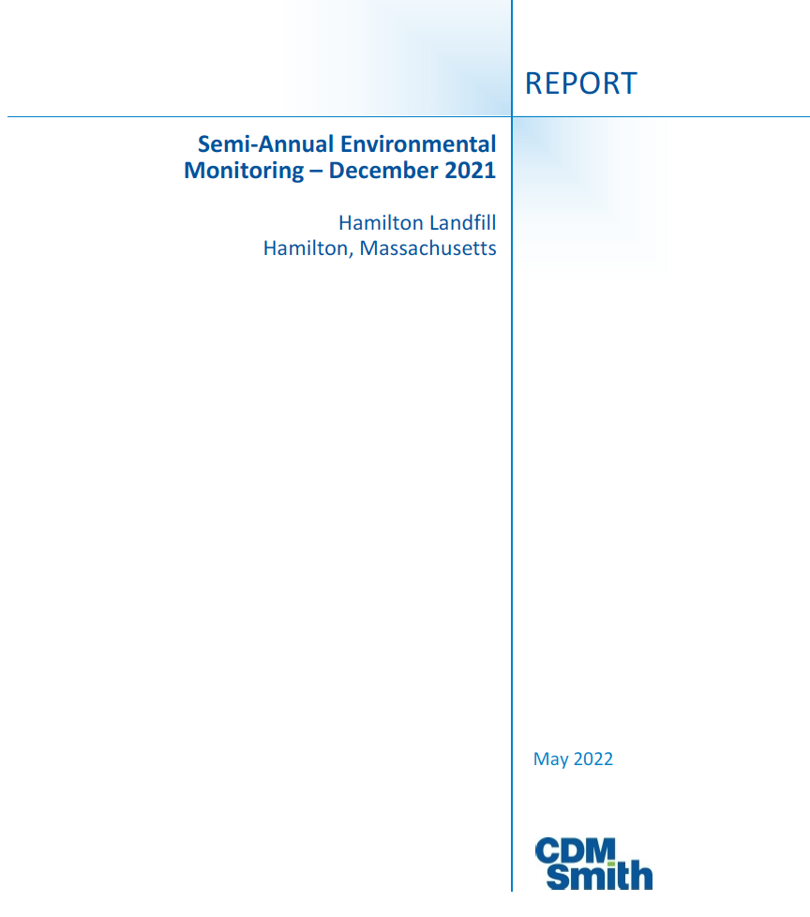

Slide 8
Infiltration System
Memorial Elementary School
Stormwater Plan

Slide 10
Lincoln Street Wellfield
Zone 1 – 400’ radius
Zone 2 – groundwater contributing area

