Slide 1
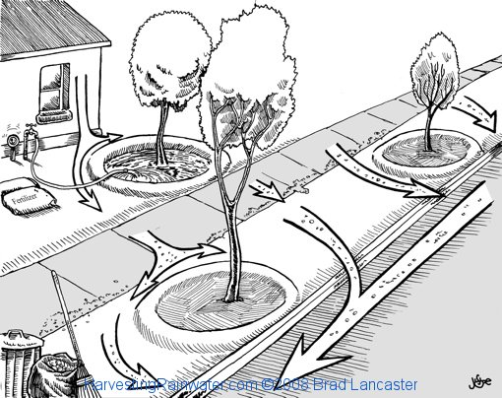
Notes:
We don’t just harvest rain water from our roof

Slide 2
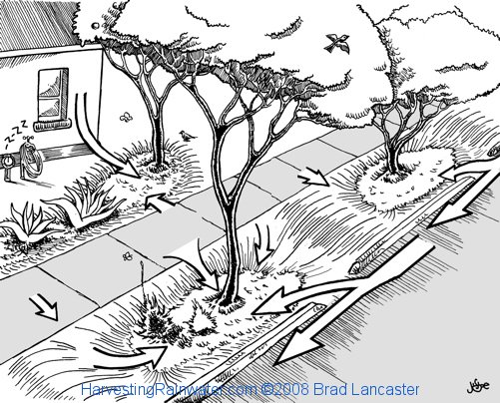

Slide 3
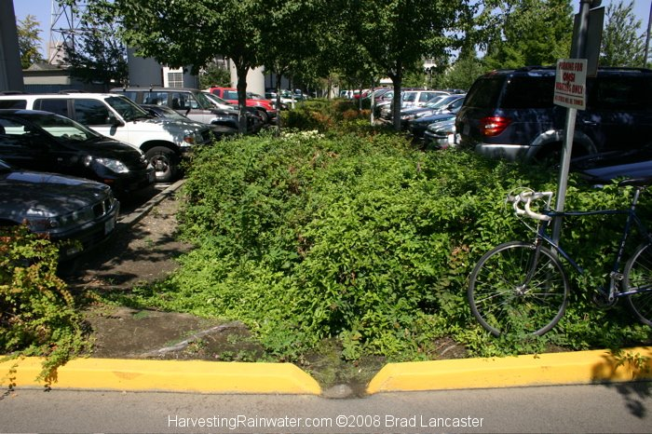
Curb cuts

Slide 4
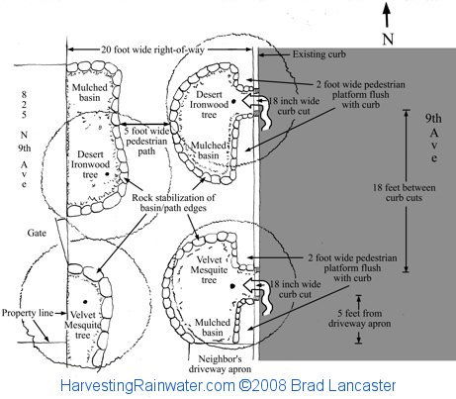

Slide 5
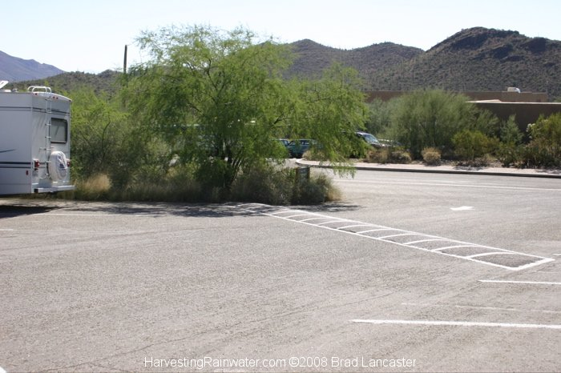
Notes:
Tell me what you notice about this photo? The speed bump is put at such an angle that it is being used to direct water to those trees, stacking function!

Slide 6
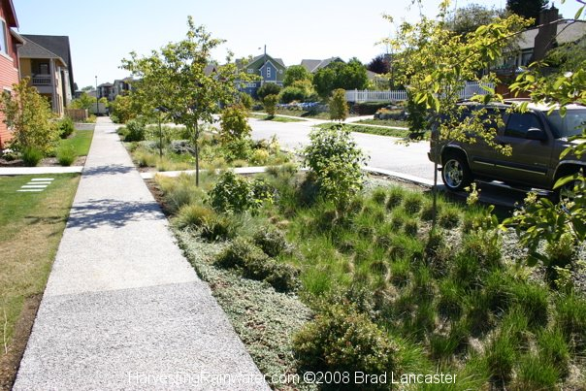
Notes:
Inverted areas, not only capturing water but also increasing growing space
How do we create urban landscapes that are ready to receive water

